Slide 1
SNAKE (KHAI KHAI)
prepared by
Vishal Sarkar
Sourav Banerjee
Supratim Marik
Sourya Kandar

Slide 2
highlights
BRIEF DISCUSSION ABOUT VB
ABOUT SNAKE
SNAKE (KHAI-KHAI) IN VB 6.0
FEATURES
SCREENSHOTS
FUTURE PLANS
LIMITATIONS
ESTIMATION
APPLICATION OF THE PROJECT
DEMO OF THE GAME
WEB REFERENCES
ACKNOWLEDGEMENT

Slide 3
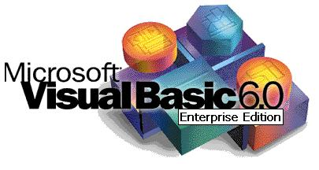
ABOUT VISUAL BASIC
Visual Basic is an event-driven programming language
Visual Basic is a third generation programming language
First came out in 1991, VB 6 came out later in 1998
Alan Cooper created the drag and drop design for the user interface of Visual Basic.
VB 6 is compatible even with the latest Windows OS.

Slide 4
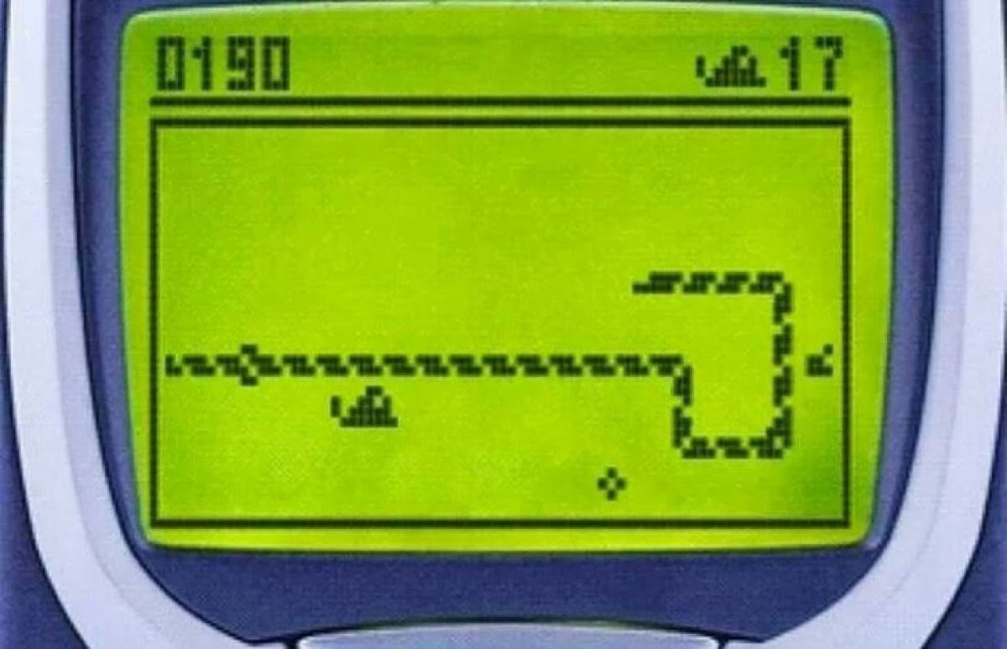
ABOUT SNAKE
Snake is a video game first released during the mid-1970s in arcades
After it became the standard preloaded game on Nokia phones in 1998, Snake found a massive audience.
The player controls a long, thin creature, resembling a snake
Each time the snake eats a piece of food, its tail grows longer, making the game increasingly difficult.
The game ends when the snake hits any walls or its own body.
Today there are versions of snakes in many languages such as HTML5, Java, Flash, etc.

Slide 5
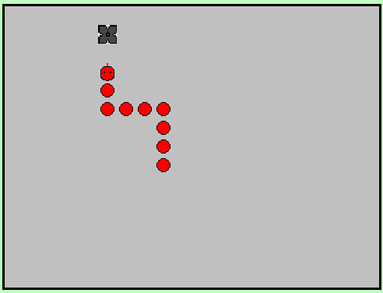
SNAKE(KHAI-KHAI) IN VB 6.0
In our project, we have decided to implement the famous game “Snake” on VB 6.0
The size of the game is very low and the codes as well as the graphics are simple.
It is a great VB project for beginners.
Our game divided into 3 levels. i.e., easy, medium, and hard.

Slide 6
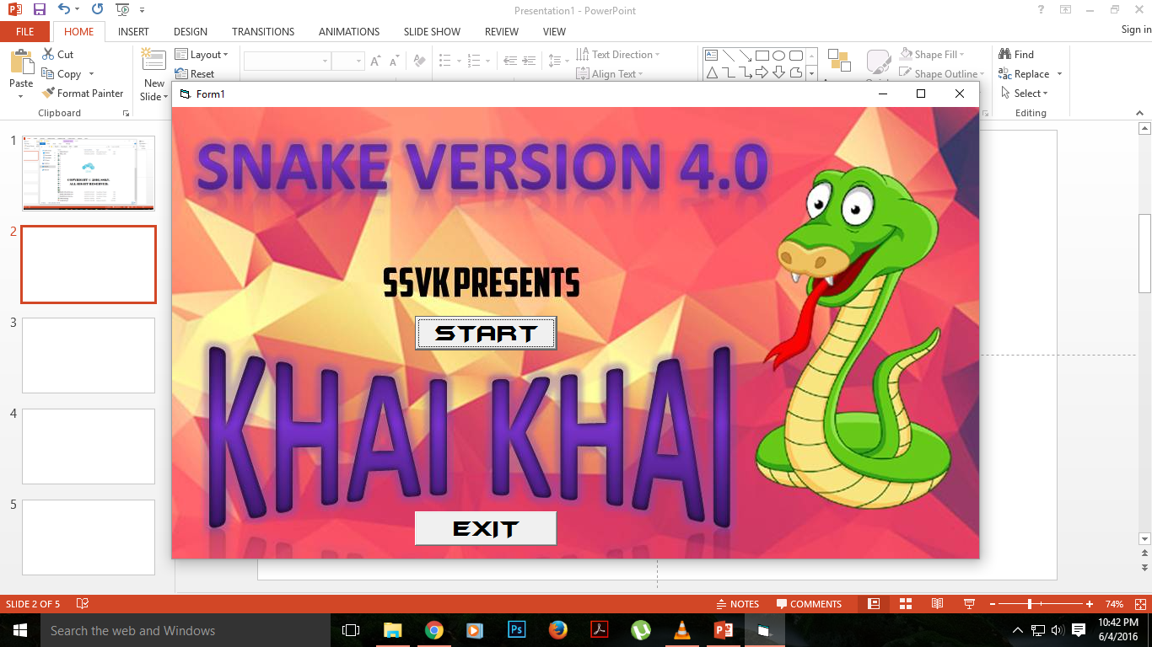
FEATURES
It is a very easy to understand and addictive game.
It is very lightweight and consumes minimal RAM.
It has three difficulties: Easy, Medium and Hard contains 5,10,20 points respectively.
Runs on Windows operating systems only.

Slide 7
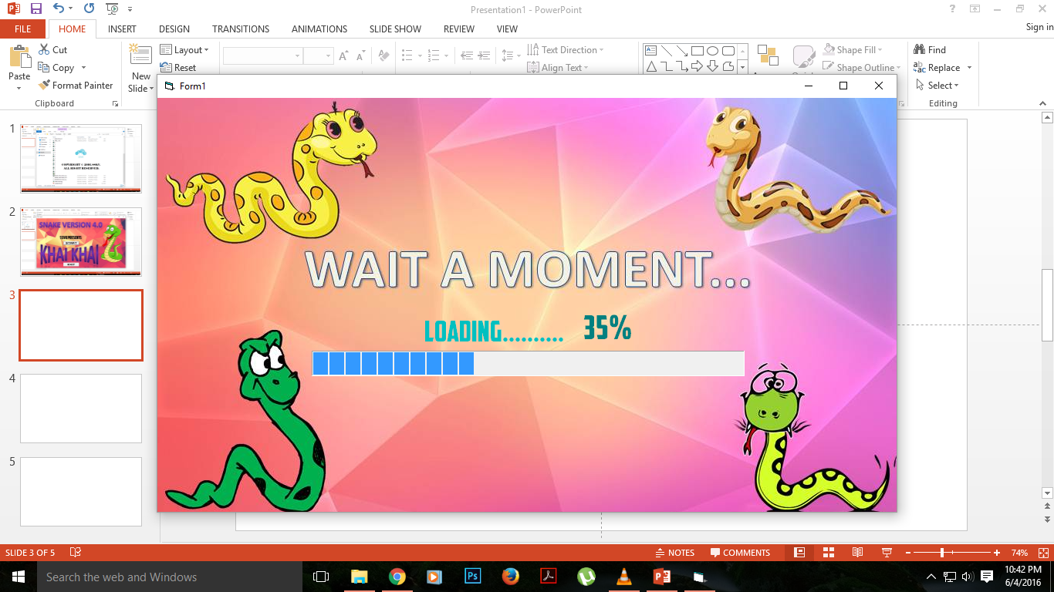
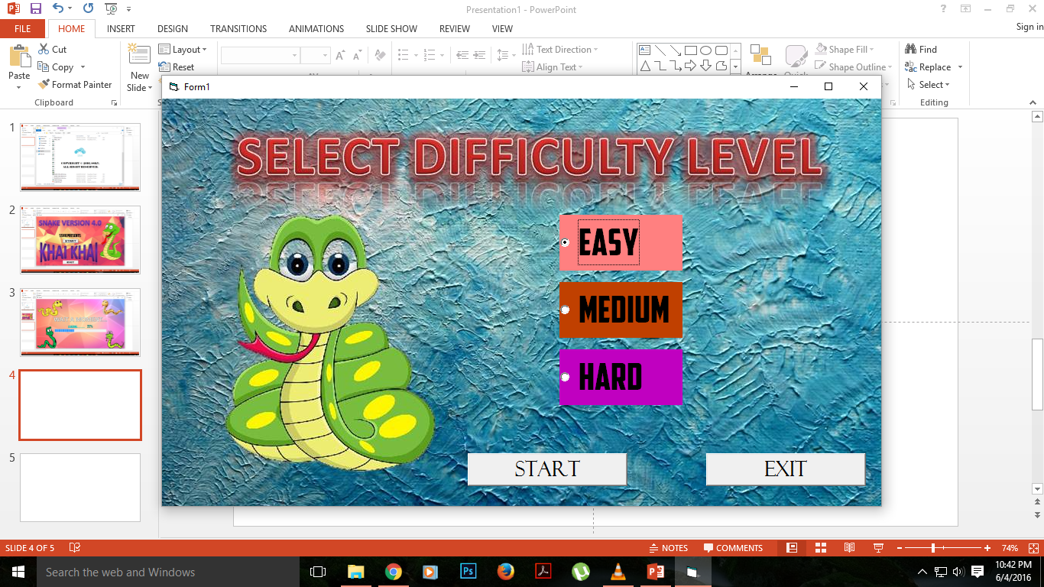
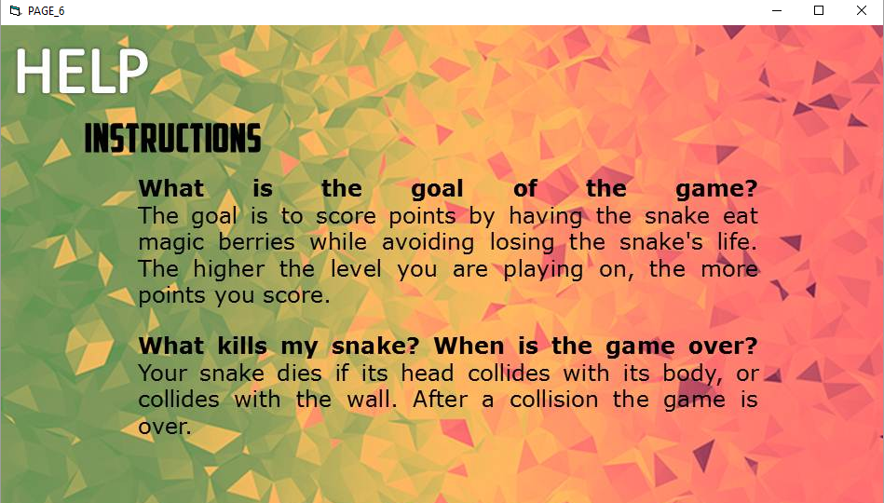
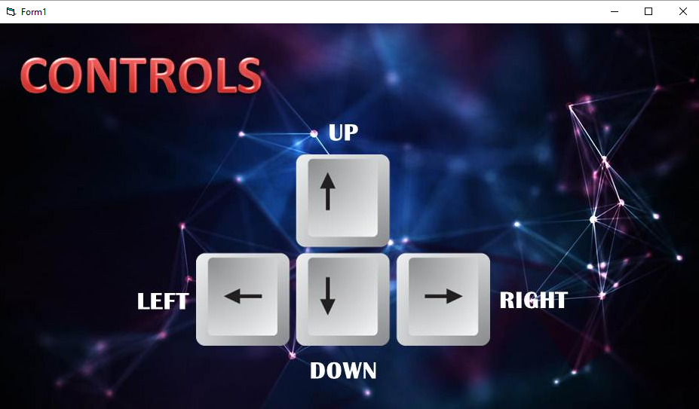
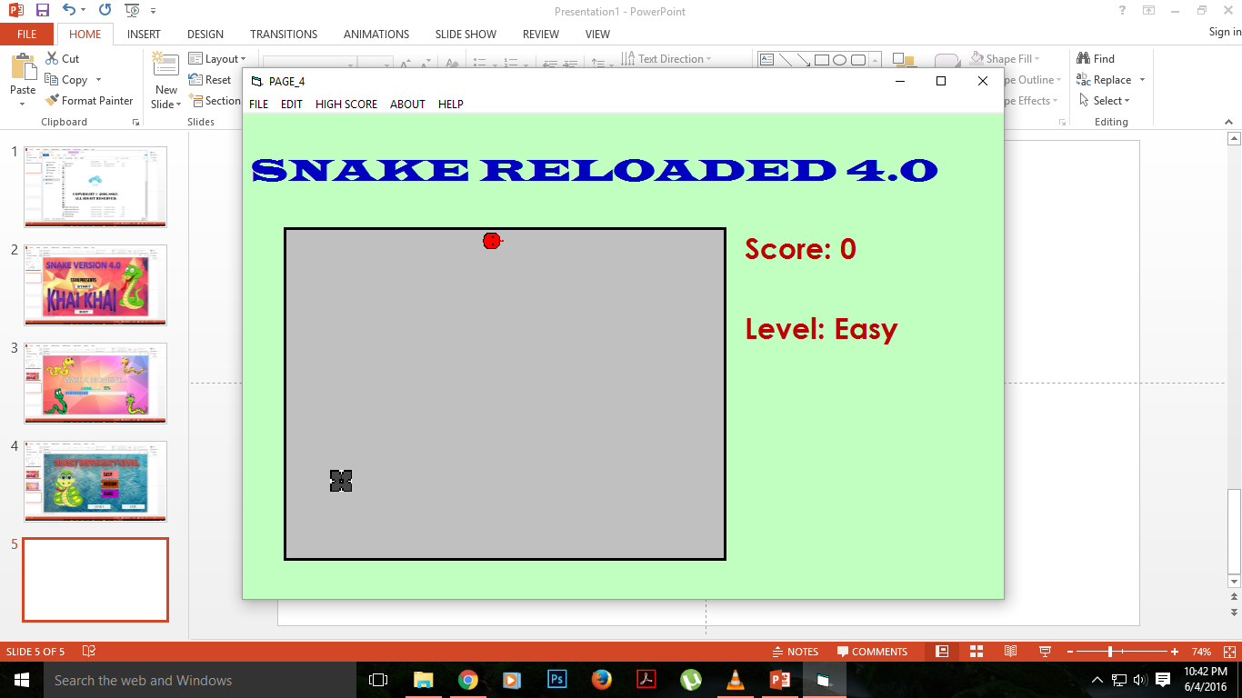
SCREENSHOTS

Slide 8
FUTURE PLANS
Graphics and inner mechanisms of the game will be updated to more modern standards.
We want to try this game on many other languages. Like HTML, PHP, JAVA, C, C++, and the upper versions of VB like 2008, 2010, 2015.

Slide 9
LIMITATIONS
This project has been developed using Visual Basic 6.0 and therefore it is only compatible with windows systems.
The mechanisms of this game is inferior to the snake games of many other platforms.

Slide 10
ESTIMATION
Cost Estimation:--
The development cost for this program is very low and thus it can be developed by anyone with a computer having Visual Basic 6.0
Software Size Estimation:--
The overall size of this game is a mere 816 kilobytes (KB) which is very low. It is very portable and also consumes very less RAM. But as we every day implement new things in the game so it is gained in size day by day.

Slide 11
APPLICATION OF THE GAME
DEVELOP FOCUS AND MEMORY
IMPROVE HAND EYE COORDINATION
STREET BUSTER
AND ALSO FOR THE FUN

Slide 12
DEMO OF THE GAME

Slide 13
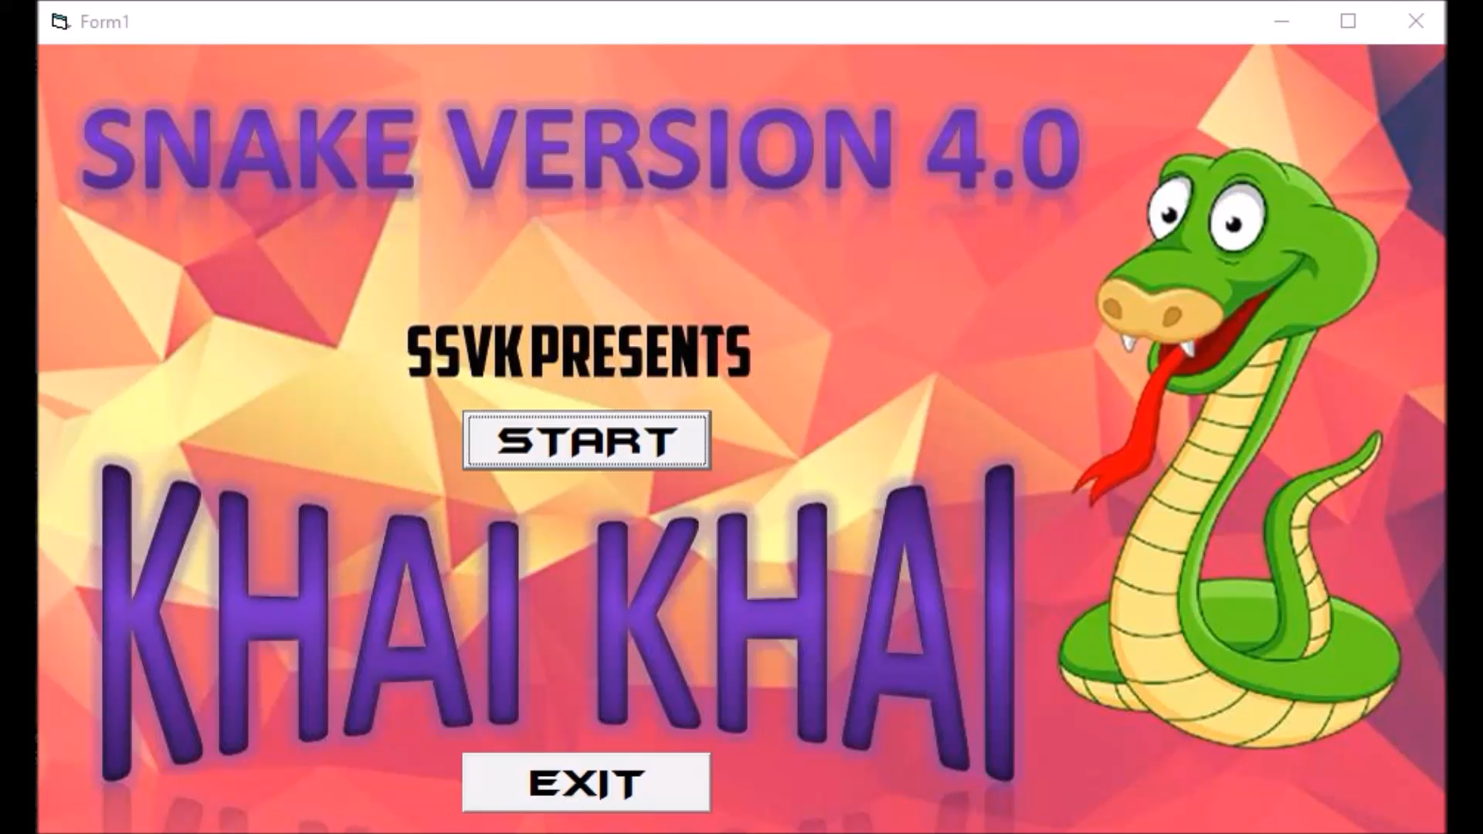

Slide 14
WEB REFERENCES
Visual Basic Game Programming for Teens - Jonathan S. Harbour.
Visual Basic to Advance - Dasgupta Soma.
Programming Microsoft® Visual Basic® 6.0 1st Edition – Francesco Balena.
Microsoft Visual Basic 6.0: Games Programming - Catherine Dwyer , Jeanine Meyer.

Slide 15
ACKNOWLEDGEMENT
SANDIP ROY (Assistant Professor Department of Computer Science & Engineering, BRAINWARE GROUP OF INSTITUTIONS.)

Slide 16
THANK YOU……

